Slide 1
Feature Engineering / Feature Selection

Slide 2
Feature Engineering
For a model to become successful, the variables / parameters that are used to construct the model are critical. In their raw form, the variables may not be (usually are not) in a state where they can be used for modeling
Feature engineering is the process of transforming data from the raw state to a state where it becomes suitable for modeling.
It transforms the data columns into features that are better at representing a give situation in terms of clarity.
Quality of the feature in distinctly representing an entity impact the quality of the model in predicting the behavior of the entity
Exploratory Data Analytics (EDA) is the first step towards feature engineering as it is critical to assess the quality of the raw data, plan the transformations required

Slide 3
Exploratory data analytics (EDA)
Some of the key activities performed in EDA include –
Meaningful standardized names to the attributes
Meta information about the data. Describe the column level details such as what it is, how it was collected, units of measurement, frequency of measurement, possible range of values etc.
List and address the challenges that one will face using the data in its existing form. For e.g. missing values, outliers, data shift, sampling bias
Descriptive stats – spread(central values , skew, tails), mixup of gaussians
Data distribution across different target classes (if in classification domain)
Outlier analysis and strategy for imputations
Assessing the impact of the actions taken on the data (modified the distribution?

Slide 4
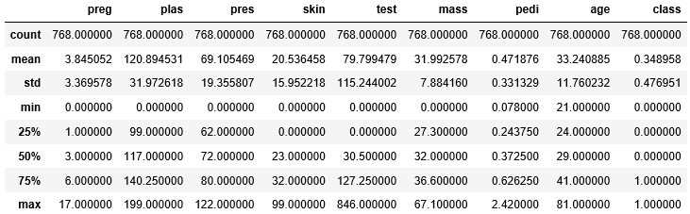
Ref: PIMA_Feature%20Engineering.ipynb
Missing Values
pima.describe()
Relatively long tail on higher side of the central values
Mean and Median differ but not too badly. Except in
‘test’, ‘pedi’
Few extreme outliers except in ‘test’, ‘pedi’ which seems to have many outliers

Slide 5
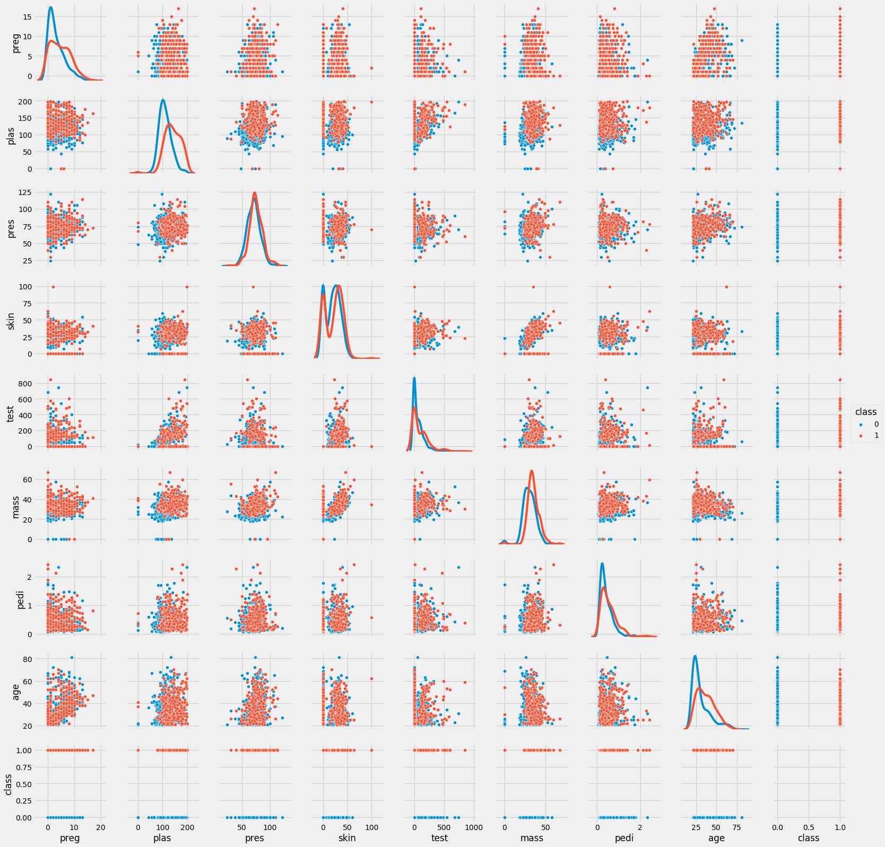
Long tails are seen on ‘test’, ‘pedi’ columns
On all the columns the distribution of the two classes are completely eclipsing one another
With minor differences in the distribution in ‘age’, ‘plas’
None of the columns can be good differentiators

Slide 6
Exploratory data analytics (EDA)
Some of the key activities performed in EDA include –
Transform the raw data into useful attributes by generating derived attributes from existing attributes if the derived attributes are likely to be better than original attributes in information content
Transform the data attributes using valid mathematical transformations such as log transformation of the distribution, if the transformed data is likely to help create simpler model without loosing information

Slide 7
Lab – 1
Load the data_banknote_authentication.txt file
Analyze the data column wise
Handle missing values if any
Detect and handle outliers if any
Compare the distributions with the Pima Diabetes distribution. Why does this data set give such high degree of accuracy while Pima data set does not
Could we have done better in handling the outliers instead of replacing the outliers with central values. (how about class wise outlier analysis and replacing with 2standard dev?

Slide 8
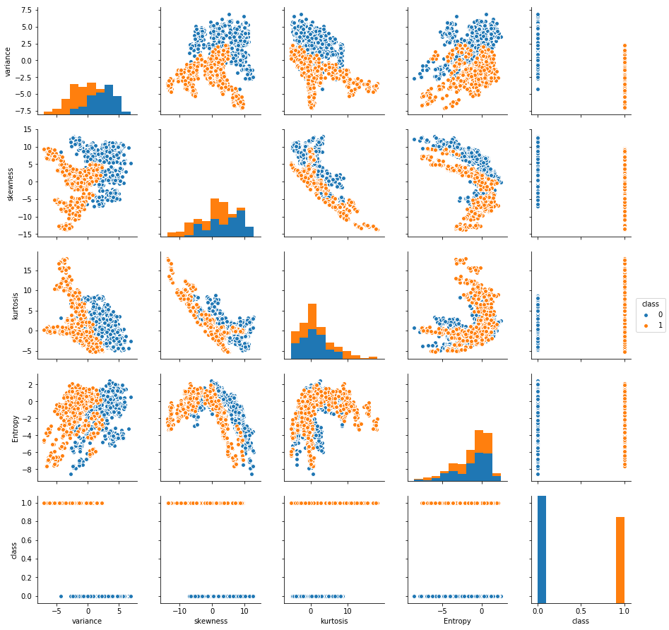
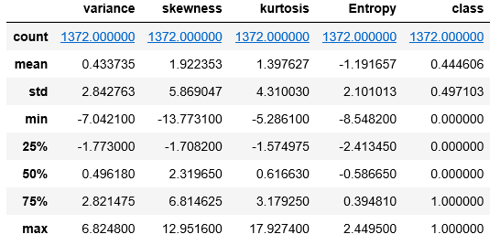
Lab – 1
data_banknote_authentication.txt
Do you think replacing outliers with central values was a good strategy? Could we have done something different
What changes do you notice in the pair plot on the different dimensions after the outlier handling
Do you think the score will be higher than the model on original data?
Look at the scales of the pairplot before and after we converted to Z score, do you think there was a need to do that?
Both in Pima dataset and this dataset, the classes are overlapping on every dimension. But models on this data give much better results. Why?
Ref:SVC_Bank_Note_Kernels.ipynb

Slide 9
Feature Engineering on Numeric data
Integers and floats are the most common data types that are directly used in building models. Instead, transforming them before modelling may yield better results!
Feature engineering on numerical columns may take the form of-
scaling the data if using algorithms that involve similarity measurements based on distance calculations
Transforming the distributions using mathematical techniques such as exponential distribution to almost normal using log functions
Binning the numeric data followed by binarization for e.g. using one-hot coding
Binning can help make linear models powerful when the data distribution on predictors is spread out though it has a trend
Interaction & Polynomial features – Another way to enrich feature representation, especially in linear models is using interaction features , polynomial features
In the binning example the linear model creates constant value in each bin (intercept), however, we can also make it learn the slope by including the original feature
Ref: Feature_Transform.ipynb

Slide 10
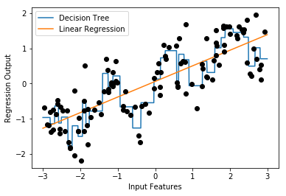

Feature Engineering on Numeric data
Linea Model and Binning, OneHotCoding
A comparison of decision tree and a simple linear model on the given data
Decision tree is more flexible and does better than linear model
Suppose we have to build linear model only, we can use binning to enrich the attributes
Note: This example uses a package mglearn which is available on Git (https://github.com/amueller/mglearn) and is used with a book “Introduction to Machine Learning with Python”

Slide 11
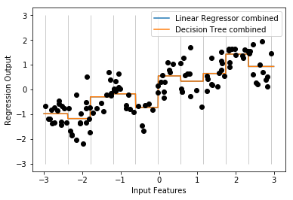
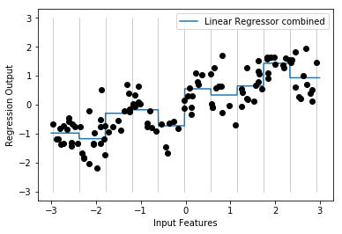

Feature Engineering on Numeric data
Linear Model and Binning, OneHotCoding
After binning, the decision tree boundaries and linear regression boundaries are exactly same. They are overlapping.
For each bin, both models are predicting a single value as output
Comparing the linear models before binning and after binning, we can see that the linear model has become more flexible.
Note: This example uses a package mglearn which is available on Git (https://github.com/amueller/mglearn) and is used with a book “Introduction to Machine Learning with Python”

Slide 12
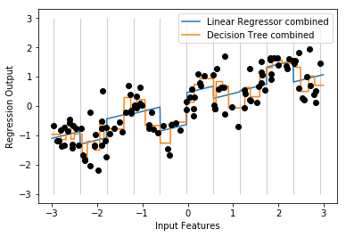
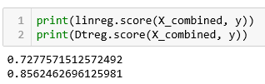
Feature Engineering on Numeric data
Linear Model with binning and original value combined
The input data is not only the bins but also include the original X column
Presence of the original column with each bin, introduces a slope and offset for each bin. For e.g. [-0.75275929, 0. , 0. , 0. , 1. , 0. , 0. , 0. , 0. , 0. , 0. ]
Linear model performance as marginally gone up
Decision tree, given it’s non-parametric property, has become more complex and hence accurate
Note: This example uses a package mglearn which is available on Git (https://github.com/amueller/mglearn) and is used with a book “Introduction to Machine Learning with Python”

Slide 13
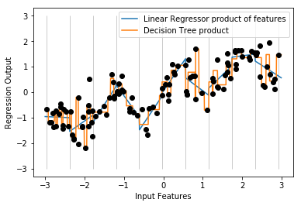

Feature Engineering on Numeric data
Linear Model with binning and interaction features
Create an interaction feature by using simple multiple operation. For e.g. X_product = np.hstack([X_binned, X_binned * X])
The input data now has onehotcoded bins with one bin carrying the original value for e.g. [ 0. , 0. , 0. , 1. , 0. , 0. , 0. , 0. , 0. , 0. , -0. , -0. , -0. , -0.75275929, -0. , -0. , -0. , -0. , -0. , -0. ]
Note: This example uses a package mglearn which is available on Git (https://github.com/amueller/mglearn) and is used with a book “Introduction to Machine Learning with Python”

Slide 14
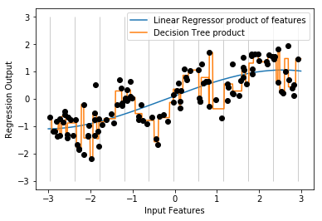

Feature Engineering on Numeric data
Linear Model with binning and polynomial features
Create polynomial features from the original column using the function poly = PolynomialFeatures(degree=3, include_bias=False)
In this example degree is 3 which means we will have x, x^2, x^3 as our features
As expected, decision tree overfits while the linear model seems underfit at this degree
Note: This example uses a package mglearn which is available on Git (https://github.com/amueller/mglearn) and is used with a book “Introduction to Machine Learning with Python”

Slide 15
Feature Engineering on Numeric data
Linear Model with binning and polynomial features
Create polynomial features from the original column using the function poly = PolynomialFeatures(degree=3, include_bias=False)
In this example degree is 3 which means we will have x, x^2, x^3 as our features
As expected, decision tree overfits while the linear model seems underfit at this degree
Note: This example uses a package mglearn which is available on Git (https://github.com/amueller/mglearn) and is used with a book “Introduction to Machine Learning with Python”

Slide 16
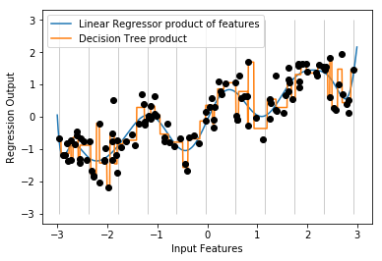

Feature Engineering on Numeric data
Linear Model with binning and polynomial features
Create polynomial features from the original column using the function poly = PolynomialFeatures(degree=15, include_bias=False)
The linear regression line is now looking a better fit
Polynomial features have a problem with extreme values or in regions where data is scant.
SVM /SVR may be a natural choice as SVR generates features using kernels automatically
Note: This example uses a package mglearn which is available on Git (https://github.com/amueller/mglearn) and is used with a book “Introduction to Machine Learning with Python”

Slide 17
Linear Regression Model -
Lab- 1- Estimating mileage based on features of a second hand car
Description – Sample data is available at https://archive.ics.uci.edu/ml/datasets/Auto+MPG
The dataset has 9 attributes listed below that define the quality
1. mpg: continuous 2. cylinders: multi-valued discrete 3. displacement: continuous 4. horsepower: continuous 5. weight: continuous 6. acceleration: continuous 7. model year: multi-valued discrete 8. origin: multi-valued discrete 9. car name: string (unique for each instance)
Sol : Ridge_Lasso_Regression.ipynb

Slide 18
Feature Selection
Suppose you have a learning algorithm LA and a set of input attributes { X1 , X2 .. Xp }
You expect that LA will only find some subset of the attributes useful.
Question: How can we use cross-validation to find a useful subset?
Some ideas:
Forward selection
Backward elimination
Mixed selection

Slide 19
Forward Selection
Begin with null model - a model that contains an intercept but no predictors
Then fit p simple linear regressions and add to the null model the variable that results in the lowest RSS(or highest R^2)
Then add to that model the variable that results in the lowest RSS(or highest R^2) for the new two-variable model
Continue this approach until some stopping rule is satisfied

Slide 20
Backward Elimination
Start with all variables in the model
Remove a variable from the above model and check the increment in RSS (or decrement in R^2) and remove the variable which has least influence, i.e., the variable that is least significant
The new (p-1) variable model is fit and the variable with the least significance is removed.
Continue this procedure until a stopping rule is reached

Slide 21
Mixed Selection
This is a combination of forward and backward selection
We start with no variables in the model and as in forward selection, we add the variable that provides the best fit
At times, the significance of variables can become low as new predictors are added to the model
Thus, if at any point, the significance for one of the variables in the model falls below a certain threshold, then we remove that variable from the model
We continue to perform these forward and backward steps until all variables in the model have a sufficiently high significance and all the variables outside the model would have a low significance if added to the model

Slide 22
Features Selection: Auto data set
Select features based on
Forward selection
Backward elimination
Mixed selection

Slide 23
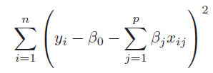
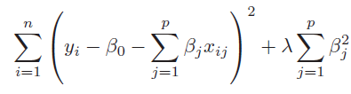
Regularising Linear Models (Shrinkage methods)
When we have too many parameters and exposed to curse of dimensionality, we resort to dimensionality reduction techniques such as transforming to PCA and eliminating the PCA with least magnitude of eigen values. This can be a laborious process before we find the right number principal components. Instead, we can employ the shrinkage methods.
Shrinkage methods attempt to shrink the coefficients of the attributes and lead us towards simpler yet effective models. The two shrinkage methods are :
Ridge regression is similar to the linear regression where the objective is to find the best fit surface. The difference is in the way the best coefficients are found. Unlike linear regression where the optimization function is SSE, here it is slightly different
The term is like a penalty term used to penalize large magnitude coefficients when it is set to a high number, coefficients are suppressed significantly. When it is set to 0, the cost function becomes same as linear regression cost function
Linear Regression cost function
Ridge Regression with additional term in the cost function

Slide 24
Regularising Linear Models (Shrinkage methods)
Why should we be interested in shrinking the coefficients? How does it help?
When we have large number of dimensions and few data points, the models are likely to become complex, overfit and prone to variance errors. When you print out the coefficients of the attributes of such complex model, you will notice that the magnitude of the different coefficients become large
Large coefficients indicate a case where for a unit change in the input variable, the magnitude of change in the target column is very large.
Coeff for simple linear regression model of 10 dimensions
Coeff with polynomial features shooting up to 57 from 10
-9.67853872e-13 -1.06672046e+12 -4.45865268e+00 -2.24519565e+00 -2.96922206e+00 -1.56882955e+00 3.00019063e+00 -1.42031640e+12 -5.46189566e+11 3.62350196e+12 -2.88818173e+12 -1.16772461e+00 -1.43814087e+00 -7.49492645e-03 2.59439087e+00 -1.92409515e+00 -3.41759793e+12 -6.27534905e+12 -2.44065576e+12 -2.32961194e+12 3.97766113e-01 1.94046021e-01 -4.26086426e-01 3.58203125e+00 -2.05296326e+00 -7.51019934e+11 -6.18967069e+11 -5.90805593e+11 2.47863770e-01 -6.68518066e-01 -1.92150879e+00 -7.37030029e-01 -1.01183732e+11 -8.33924574e+10 -7.95983063e+10 -1.70394897e-01 5.25512695e-01 -3.33097839e+00 1.56301740e+12 1.28818991e+12 1.22958044e+12 5.80200195e-01 1.55352783e+00 3.64527008e+11 3.00431724e+11 2.86762821e+11 3.97644043e-01 8.58604718e+10 7.07635073e+10 6.75439422e+10 -7.25449332e+11 1.00689540e+12 9.61084146e+11 2.18532428e+11 -4.81675252e+12 2.63818648e+12
The coefficient for cyl is 2.5059518049385052
The coefficient for disp is 2.5357082860560483
The coefficient for hp is -1.7889335736325294
The coefficient for wt is -5.551819873098725
The coefficient for acc is 0.11485734803440854
The coefficient for yr is 2.931846548211609
The coefficient for car_type is 2.977869737601944
The coefficient for origin_america is -0.5832955290166003
The coefficient for origin_asia is 0.3474931380432235
The coefficient for origin_europe is 0.3774164680868855
Ref: Ridge_Lasso_Regression.ipynb
Very large coefficients!

Slide 25
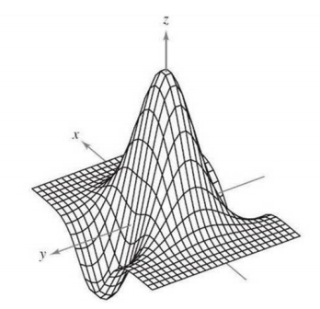
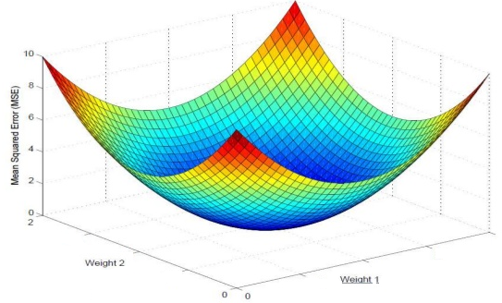
Regularising Linear Models (Shrinkage methods)
Z = f ( x, y)
Curse of dimensionality results in large magnitude coefficients which results in a complex undulated surface / model.
This complex surface has the data points occupying the peaks and the valleys
The model gives near 100% accuracy in training but poor result in testing and the testing scores also vary a lot from one sample to another.
The model is supposed to have absorbed the noise in the data distribution!
Large magnitudes of the coefficient give the least SSE and at times SSE = 0! A model that fits the training set 100%!
Such models do not generalize
= 0

Slide 26
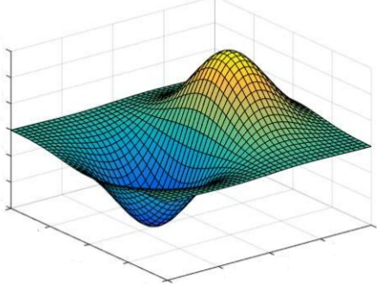
Regularising Linear Models (Shrinkage methods)
In Ridge Regression, the algorithm while trying to find the best combination of coefficients which minimize the SSE on the training data, is constrained by the penalty term
The penalty term is akin to cost of magnitude of the coefficients. Higher the magnitude, more the cost. Thus to minimize the cost, the coefficient are suppressed
Thus the resulting surface tends to be relatively much more smoother than the unconstrained surface. This means we have settled for a model which will make errors in the training data
This is fine as long as the errors can be attributed to the random fluctuations i.e. because the model does not absorb the random fluctuations in the data
Such model will perform equally well on unseen data i.e. test data. The model will generalize better than the complex model
Z = f ( x, y)

Slide 27
Regularising Linear Models (Shrinkage methods)
Impact of Ridge Regression on the coefficients of the 56 attributes
Ridge model: [[ 0. 3.73512981 -2.93500874 -2.13974194 -3.56547812 -1.28898893 3.01290805
2.04739082 0.0786974 0.21972225 -0.3302341 -1.46231096 -1.17221896 0.00856067 2.48054694
-1.67596093 0.99537516 -2.29024279 4.7699338 -2.08598898 0.34009408 0.35024058 -0.41761834
3.06970569 -2.21649433 1.86339518 -2.62934278 0.38596397 0.12088534 -0.53440382 -1.88265835
-0.7675926 -0.90146842 0.52416091 0.59678246 -0.26349448 0.5827378 -3.02842915 -0.36548074
0.5956112 -0.15941014 0.49168856 1.45652375 -0.43819158 -0.20964198 0.77665496 0.36489921
-0.4750838 0.3551047 0.23188557 -1.42941282 2.06831543 -0.34986402 -0.32320394 0.39054656 0.06283411]]
Large coefficients have been suppressed, almost close to 0 in many cases.
Ref: Ridge_Lasso_Regression.ipynb

Slide 28
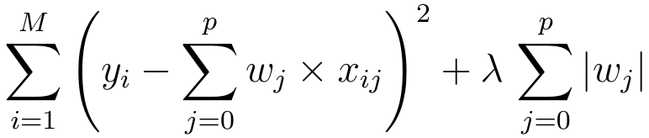
Regularising Linear Models (Shrinkage methods)
Lasso Regression is similar to the Ridge regression with a difference in the penalty term. Unlike Ridge, the penalty term here is raised to power 1. Also known as L1 norm.
The term continues to be the input parameter which will decide how high penalties would be for the coefficients. Larger the value more diminished the coefficients will be.
Unlike Ridge regression, where the coefficients are driven towards zero but may not become zero, Lasso Regression penalty process will make many of the coefficients 0. In other words, literally drop the dimensions

Slide 29
Regularising Linear Models (Shrinkage methods)
Impact of Lasso Regression on the coefficients of the 56 attributes
Lasso model: [ 0. 0.52263805 -0.5402102 -1.99423315 -4.55360385 -0.85285179 2.99044036 0.00711821 -0. 0.76073274 -0. -0. -0.19736449
0. 2.04221833 -1.00014513 0. -0. 4.28412669 -0. 0. 0.31442062 -0. 2.13894094 -1.06760107 0. -0. 0. 0. -0.44991392 -1.55885506 -0. -0.68837902 0.
0.17455864 -0.34653644 0.3313704 -2.84931966 0. -0.34340563 0.00815105 0.47019445 1.25759712 -0.69634581 0. 0.55528147 0.2948979 -0.67289549
0.06490671 0. -1.19639935 1.06711702 0. -0.88034391 0. -0. ]
Large coefficients have been suppressed, to 0 in many cases, making those dimensions useless i.e. dropped from the model.
Ref: Ridge_Lasso_Regression.ipynb

Slide 30
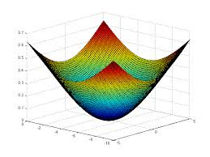
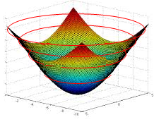

Regularising Linear Models (Comparing The Methods)
To compare the Ridge and Lasso, let us first transform our error function (which is a quadratic / convex function) into a contour graph
Every ring on the error function represents a combination of coefficients (m1 and m2 in the image) which result in same quantum of error i.e. SSE
Let us convert that to a 2d contour plot. In the contour plot, every ring represents one quantum of error.
The innermost ring / bull’s eye is the combination of the coefficients that gives the lease SSE
m2
m1

Slide 31
Regularising Linear Models (Ridge Constraint)
Most optimal combination of m1, m2 given the constraints
Yellow circle is the Ridge constraint region representing the ridge penalty (sum of squared coeff)
Any combination of m1 nd m2 that fall within yellow is a possible solution
The most optimal of all solutions is the one which satisfies the constraint and also minimizes the SSE (smallest possible red circle)
Thus the optimal solution of m1 and m2 is the one where the yellow circle touches a red circle.
Lowest SSE error ring. violates the constraint
m2
Sub-optimal combination of m1, m2. Meets constraint but is not the minimal possible SSE within constraint
Allowed combination of m1, m2 by Ridge Constraints
m1
The point to note is that the red rings and yellow circle will never be tangential (touch) on the axes representing the coefficient. Hence Ridge can make coefficients close to zero but never zero. You may notice some coefficients becoming zero but that will be due to roundoff…

Slide 32


Regularising Linear Models (Ridge Constraint)
As the lambda value (shown here as alpha) increases, the coefficients have to become smaller and smaller to minimize the penalty term in the cost function i.e. the
The larger the lambda, smaller the sum of squared coefficients should be and as a result the tighter the constraint region
The tighter the constraint region, the larger will be the red circle in the contour diagram that will be tangent to the boundary of the yellow region
Thus, higher the lambda, stronger the shrinkage, the coefficients are shrinked strongly and hence more smooth the surface / model
More smoother the surface, more likely the model is going to perform equally well in production
When we move away from a model with sharp peaks and valleys (complex model) to smoother surface (simpler models), we reduce the variance errors but bias errors go up.
Using gridsearch, we have to find the right value of lambda which results in right fit, neither too complex nor too simple a model
m2
m1

Slide 33
Regularising Linear Models (Lasso Constraint)
Most optimal combination of m1, m2 given the constraints
Yellow rectangle is the Lasso constraint region representing the Lasso penalty (sum coeff)
Any combination of m1 nd m2 that fall within yellow is a possible solution
The most optimal of all solutions is the one which satisfies the constraint and also minimizes the SSE (smallest possible red circle)
Thus the optimal solution of m1 and m2 is the one where the yellow rectangle touches a red circle.
Lowest SSE error ring. violates the constraint
m2
Sub-optimal combination of m1, m2. Meets constraint but is not the minimal possible SSE within constraint
Allowed combination of m1, m2 by Lasso Constraints
m1
The beauty of Lasso is, the red circle may touch the constraint region on the attribute axis! In the picture above the circle is touching the yellow rectangle on the m1 axis. But at that point m2 coefficient is 0! Which means, that dimension has been dropped from analysis. Thus Lasso does dimensionality reduction which Ridge does not

